Slide 1
Forward model
08/09/2023
Yu Li

Slide 2
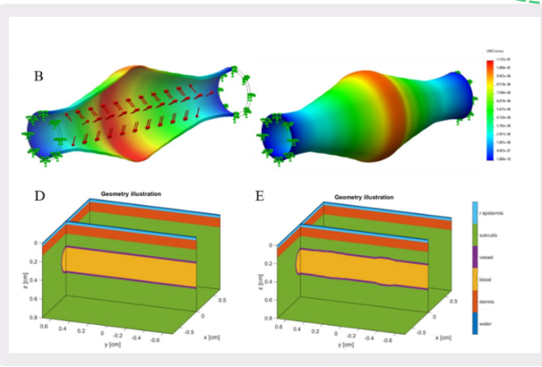
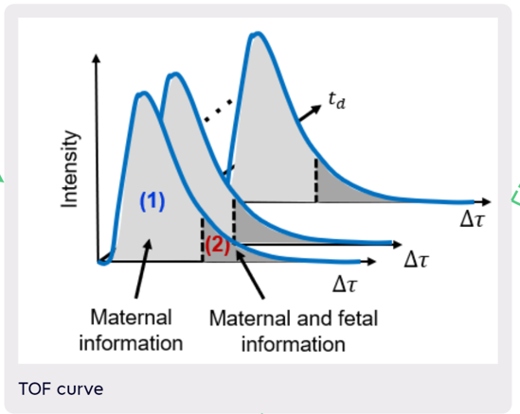
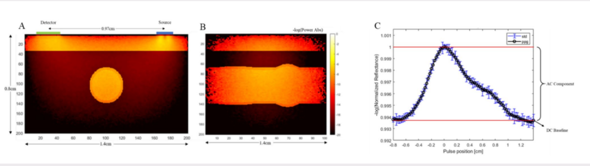
Structure
Convert the structural information into time information, and the corresponding dimension is the time axis of TOF.
The horizontal axis is the pulse position, but the shape of the curve is consistent with the pulse curve in the time domain.
Reference : Photoplethysmography (PPG) of the radial artery through parallelized Monte Carlo and its correlation to body mass index (BMI).

Slide 3
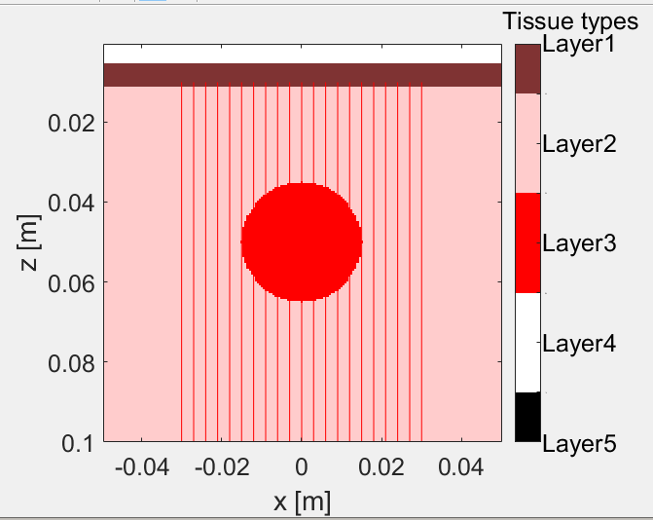
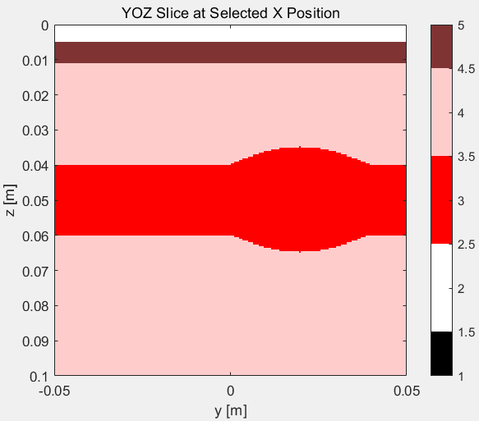
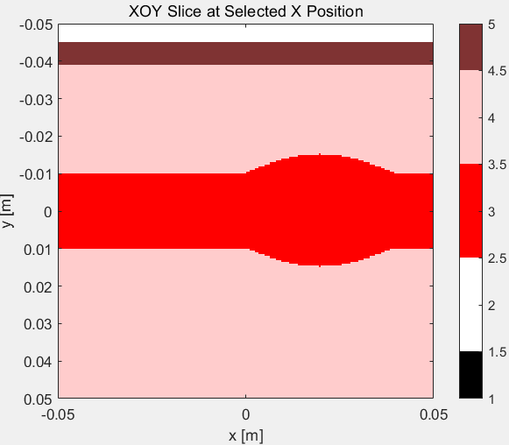
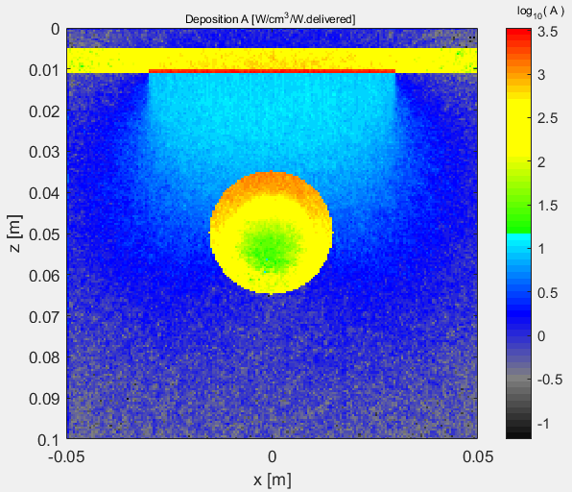
A simple Monte Carlo vascular model was built on MATLAB, and the shape of the tissue layer was set very simply.
Under our expectations, scanning the TOF curve at each location along the Y axis can simulate the TOF curve cluster in the time domain
However, there are still some problems with the organization scanning along the Y axis. The code for guessing part of the structure may only be reproduced under Unix

Slide 4
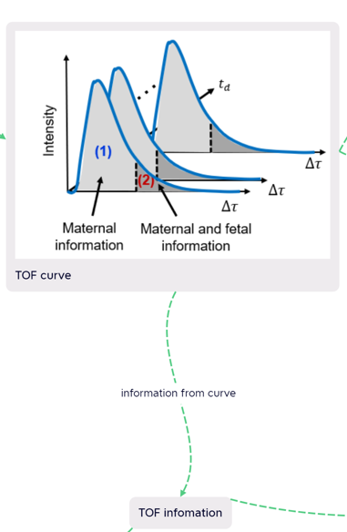
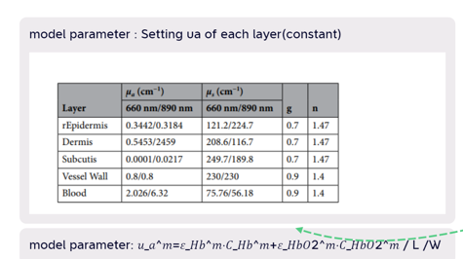
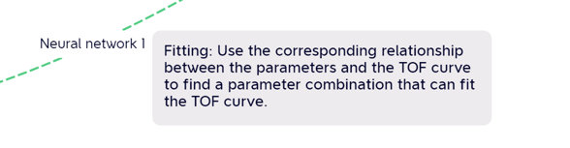
Neural network 1
The first neural network of our envisioned model is used for fitting. When we build the model of blood vessels, we actually need to set the ‘ua’ of each layer, so the ‘ua’ we finally pay attention to is actually a total ‘ua’ calculated according to this formula.
We can train a neural network based on the data of ua calculated by artificial fitting according to the TOF curve, so that the corresponding ua can be quickly obtained according to the TOF curve. This is also the inverse model I expected.

Slide 5
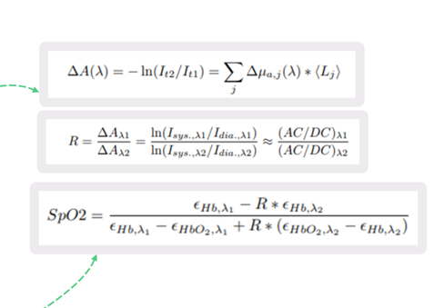
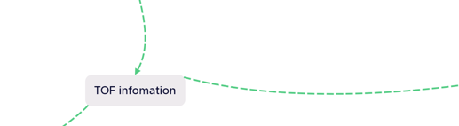
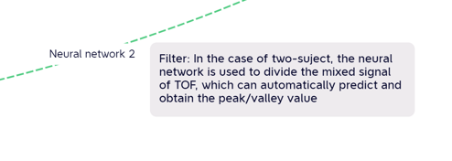
Neural Network 2
The second neural network we discussed is actually prepared for two-subject. Because a filter is required under the mixed signal, the maternal signal and fetal signal are automatically divided according to the TOF curve, and then the peak-valley value is calculated, and SPO2 is calculated according to the dMBLL formula.

